Slide 1
Terrain GENERATION
João Braga, Rafael Correia, Robert Szabo

Slide 2
TABLE OF CONTENTS
01
Biome GENERATION
02
TERRAIn GENERATION
03
FEATURES
04
Future development & Comparisons

Slide 3
01
Biome GENERATION

Slide 4
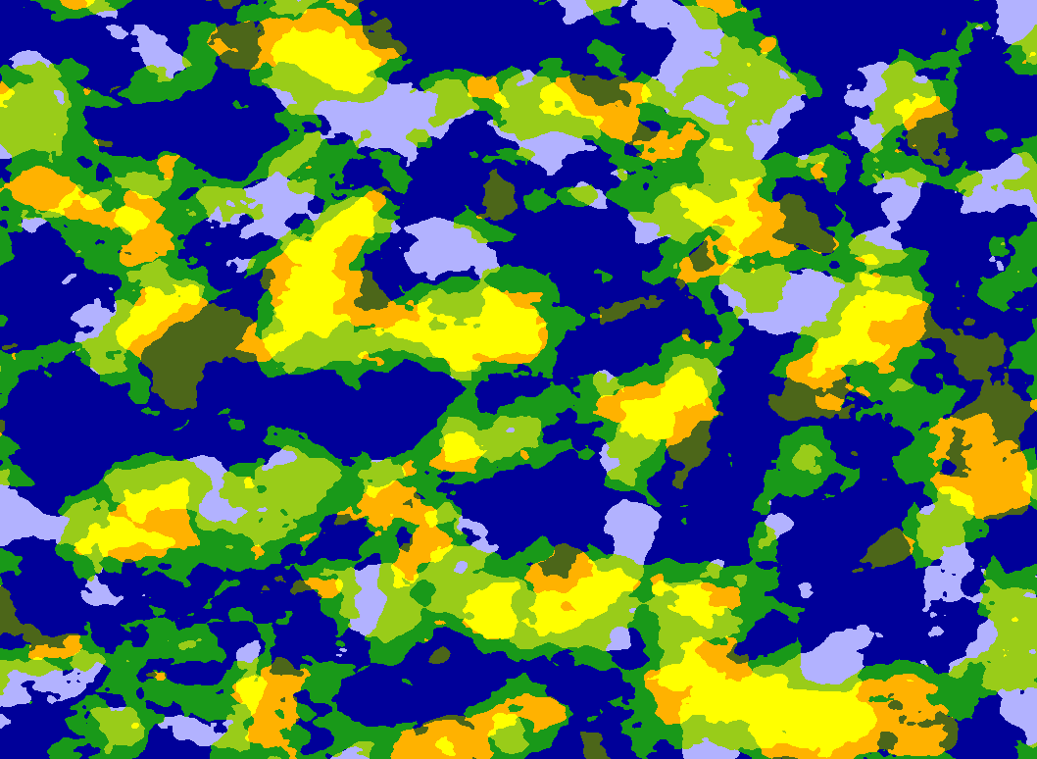
Scale Temperature num Octaves Temperature limits Precipitation Num Octaves Precipitation noise frequency precipitation limits Precipitation offsets

Slide 5
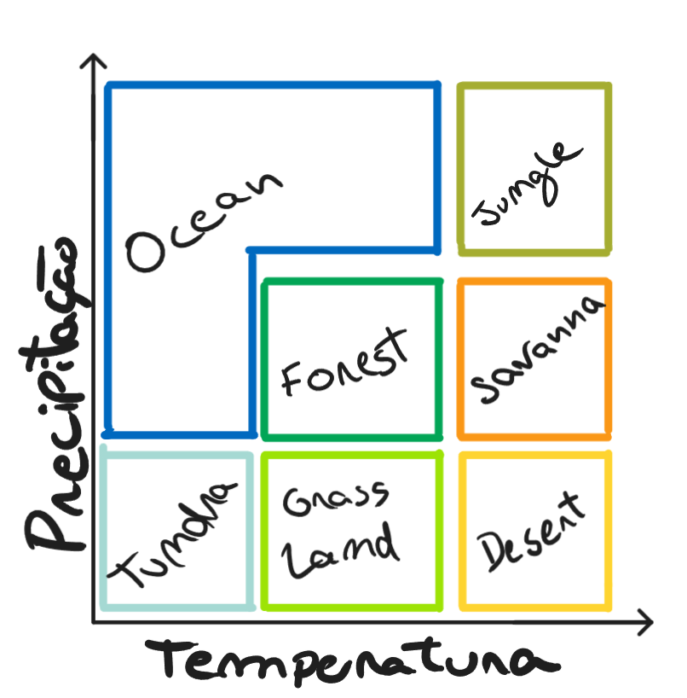
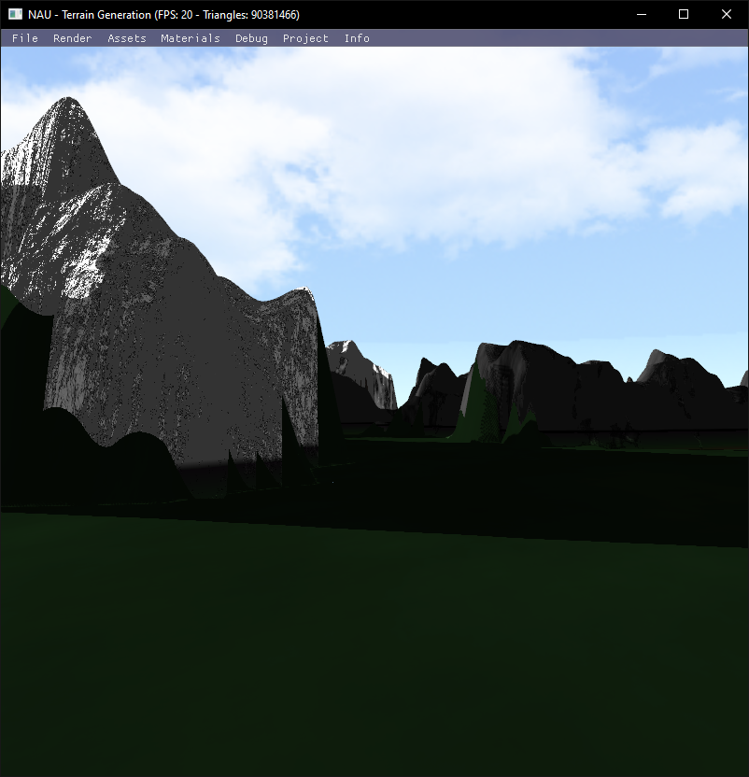

Slide 6
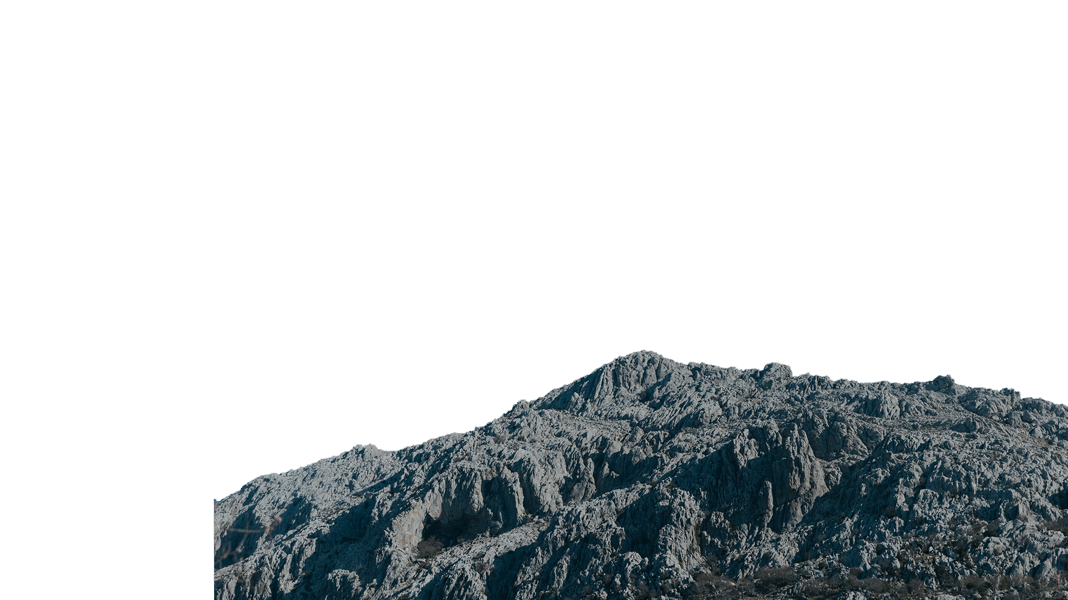
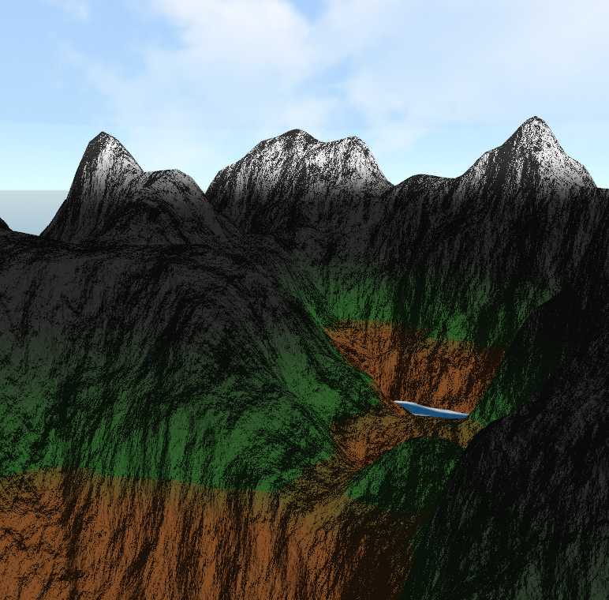
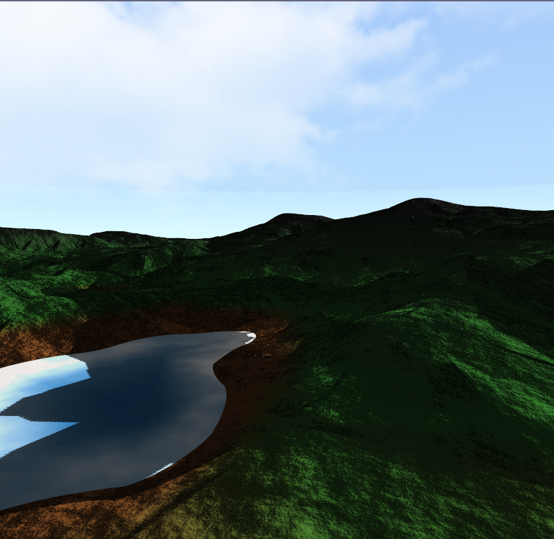
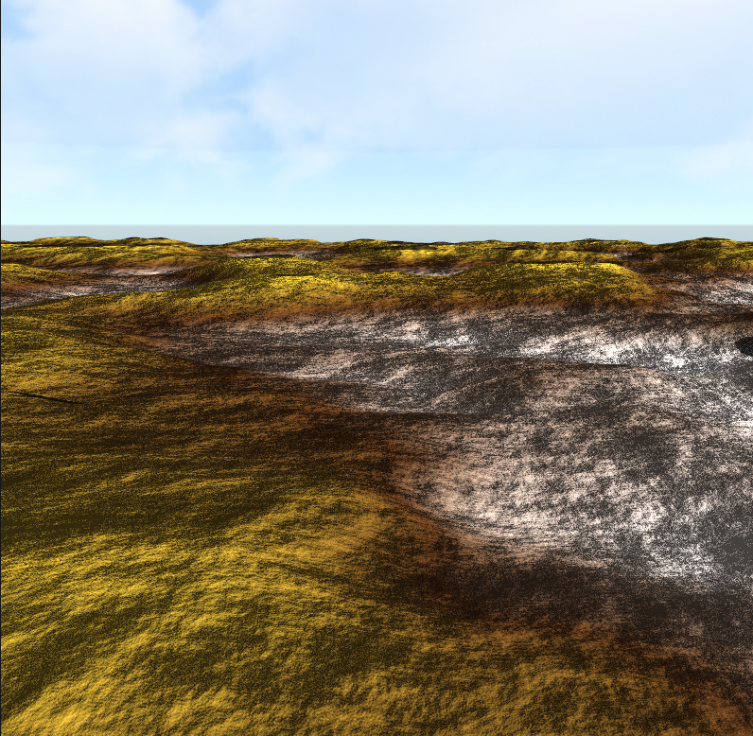

BIOMAS

Slide 7
02
TERRAIn GENERATION

Slide 8
Amplitude Frequency base height
NUM OCTAVES SCALE PERSISTENCE LACUNARITY Height MULTIPLIER

Slide 9
03
FEATURES

Slide 10
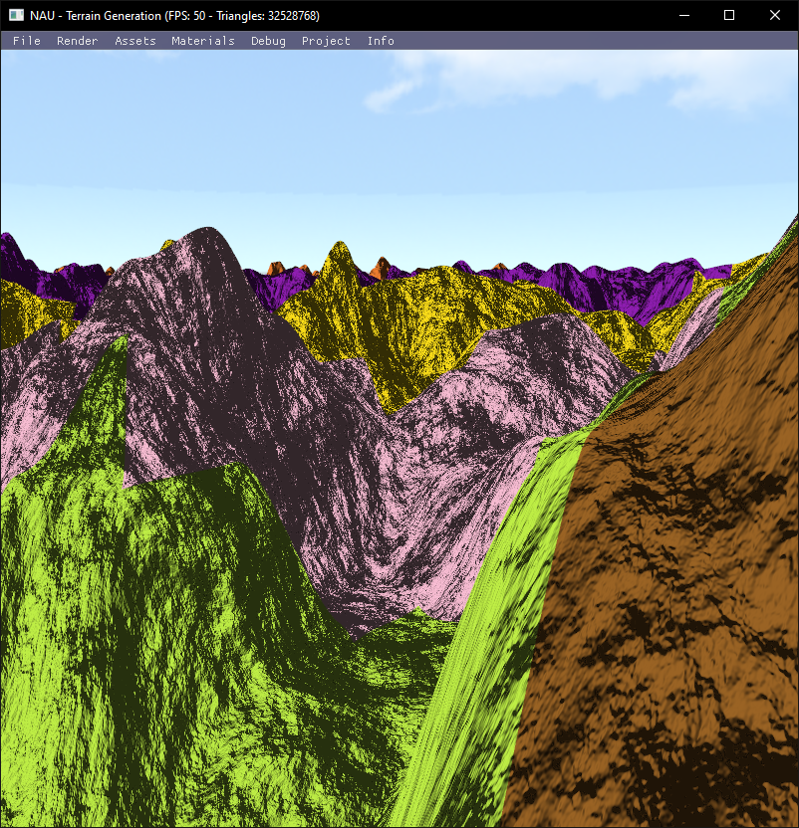
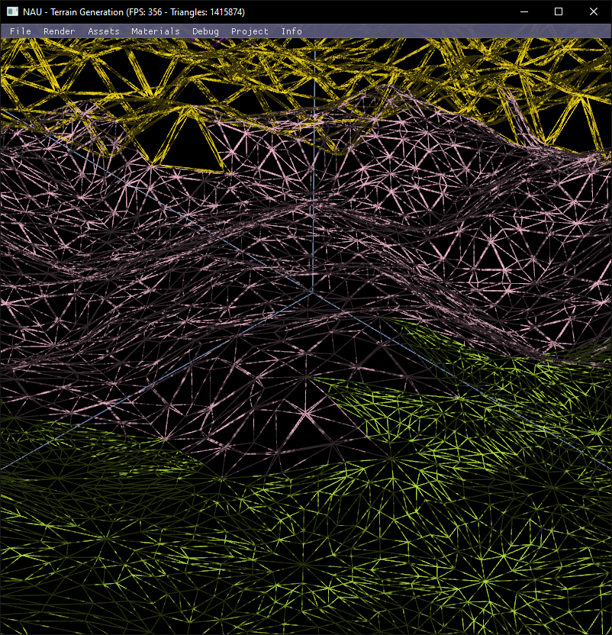
TESSELAÇÃO

Slide 11
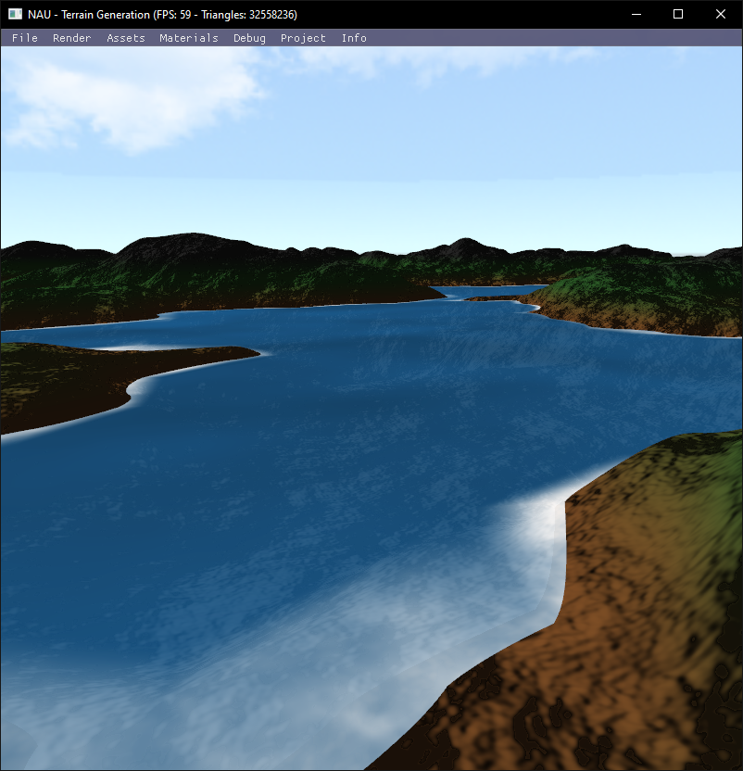
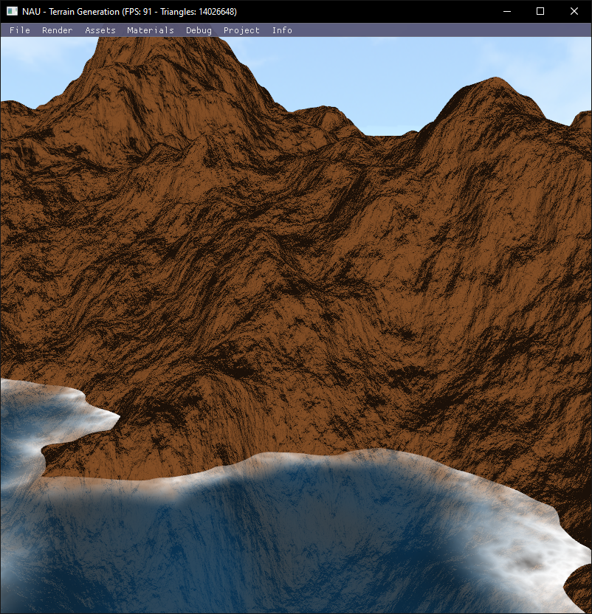
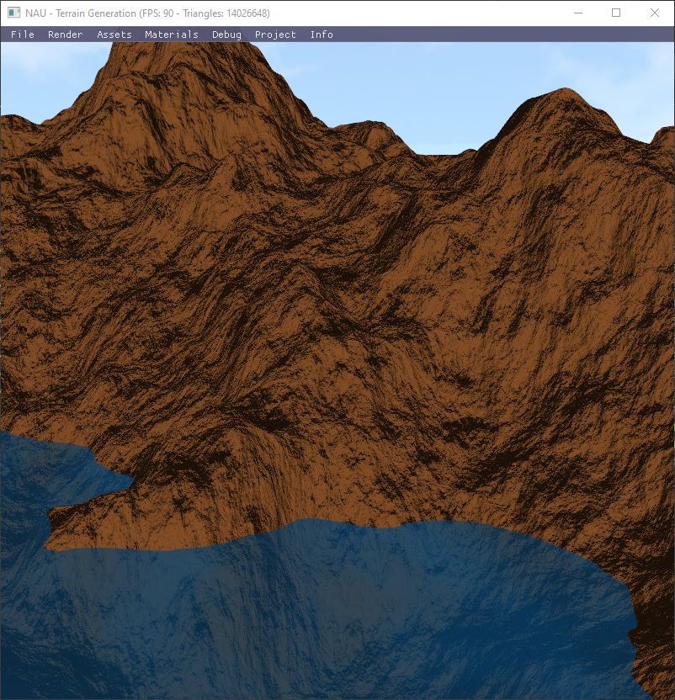
ÁGUA

Slide 12
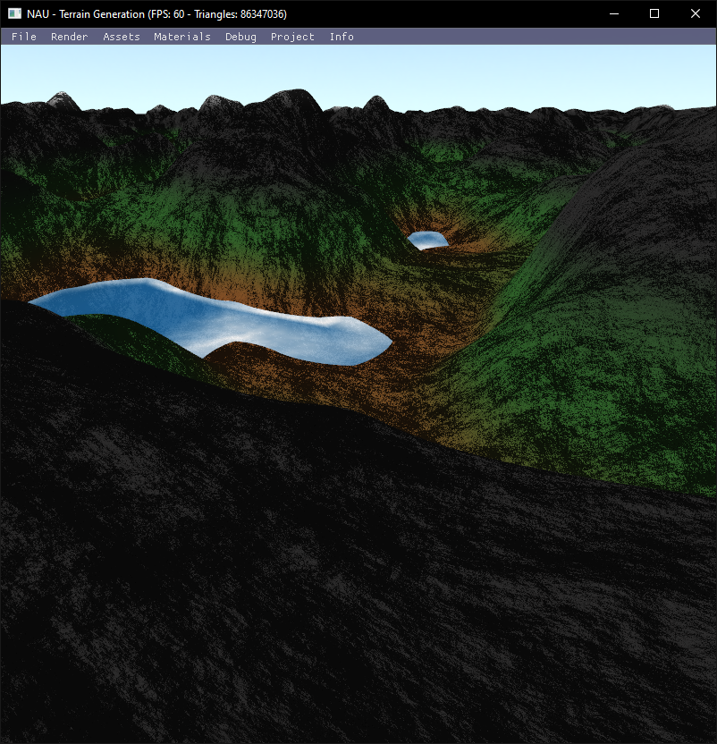
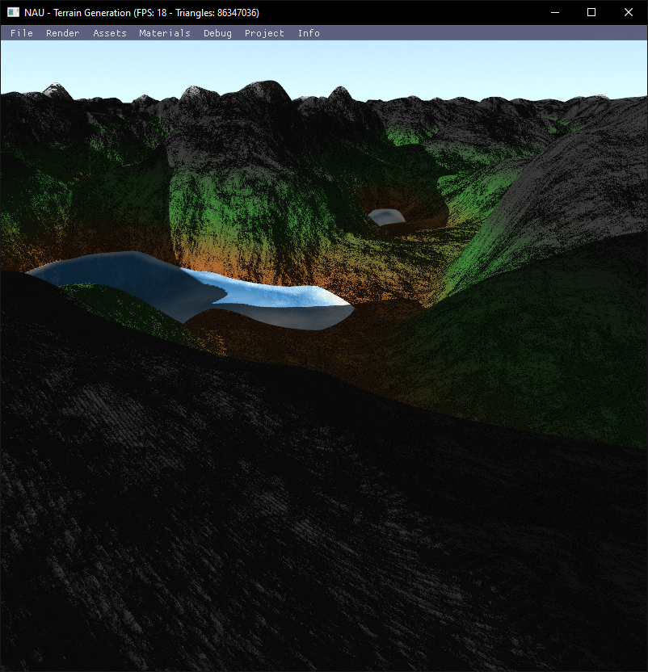
ShADOW Mapping

Slide 13
TERRENO INFINITO

Slide 14


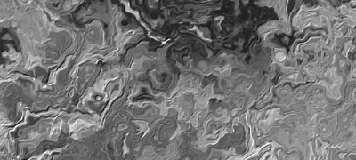
DOMAIN WARPING
fbm(p)
fbm(p + fbm(p))
fbm(p + fbm(p +fbm(p)))

Slide 15
“Thats’ all Folks !”
Made by:
João Braga PG54194
Rafael Correia PG54162
Robert Szabo PG53951

